Slide 1


SEMESTER 6 MINI PROJECT CHESSBOT
TEAM MEMBERS:
Vishnu Prem
Mohammed Yaseen Amra
Agnel Mamachan

Slide 2

Aim
AIM
The aim of this project was to create a robotic arm that can successfully play against a human opponent. The game must take place in a similar fashion as a real game of chess.

Slide 3
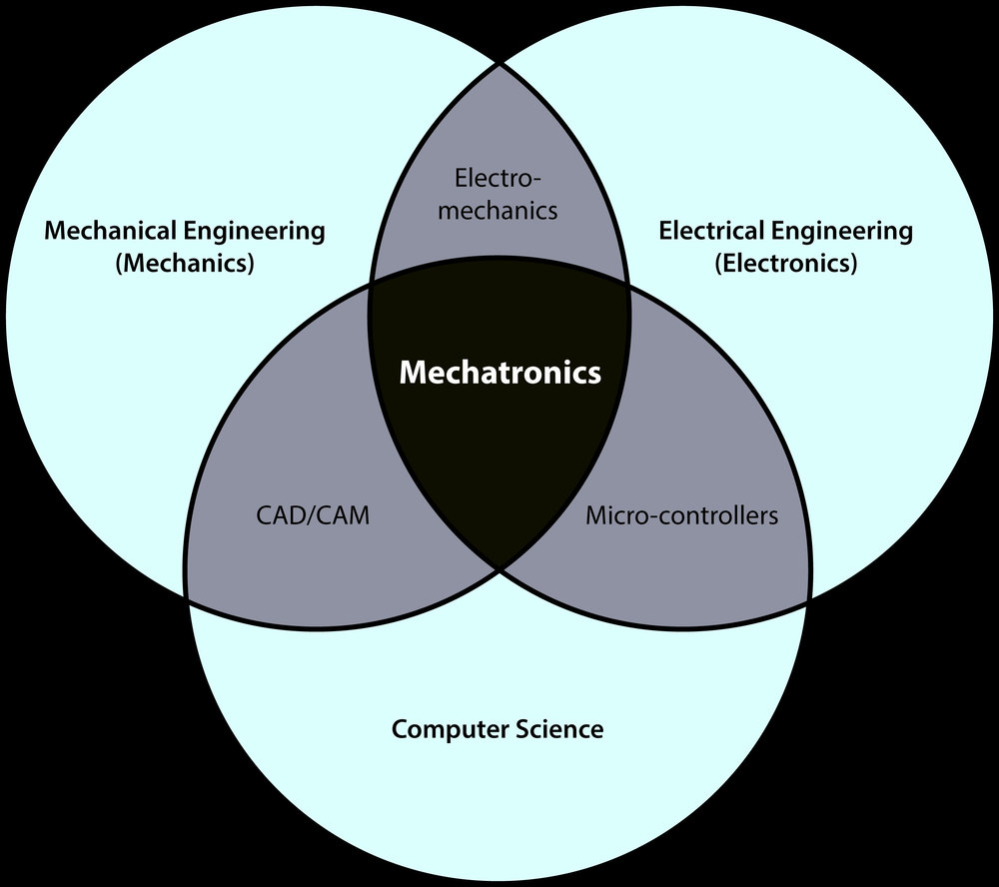
MOTIVATION
This project allows to explore various aspects of mechanical, electrical and computer science engineering as well as control theory. Hence it is an apt topic for a mechatronics project.

Slide 4
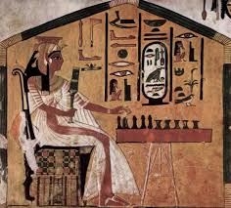
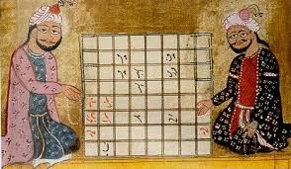
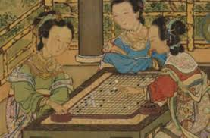
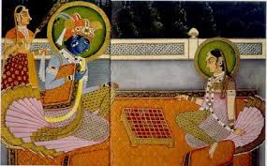
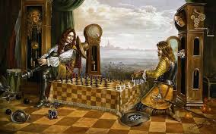
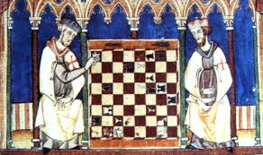
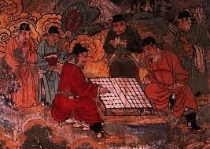
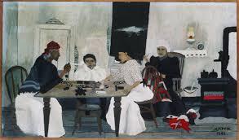
MOTIVATION
Chess was played in several cultures around the world. It is one of the oldest surviving games in history. It continues to be extremely popular today. Hence it would be interesting to see a modern twist added to this ancient game.

Slide 5
OVERVIEW
The robot plays a complete game of chess against a human opponent. It uses image processing to track the movement of pieces by the opponent. The best move to be made is then calculated after which it picks and places the required piece in order to execute the move. This process is repeated till the game comes to an end.

Slide 6
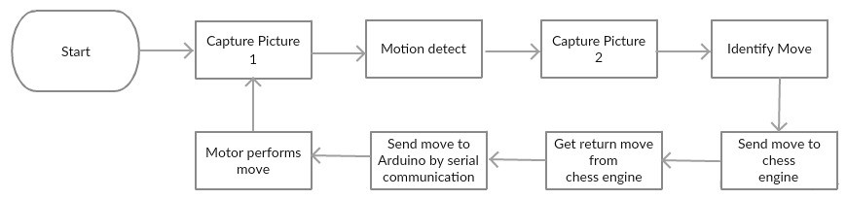
Flowchart

Slide 7
MECHANICAL ELEMENTS

Slide 8
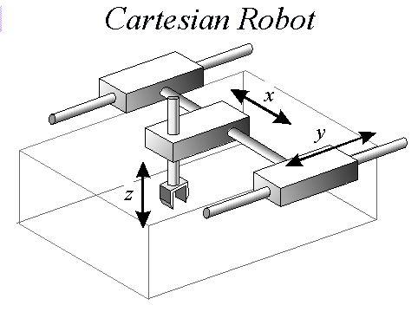
CARTESIAN ARM
The robotic arm is a cartesian arm This type of arm facilitates translatory movement in x, y and z axes.
Generalized Cartesian robotic arm

Slide 9
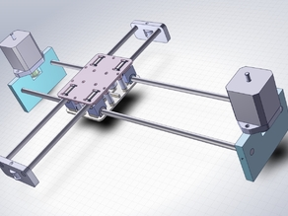
CORE XY MECHANISM
The arm employs CoreXY mechanism to achieve movement in the x and y axis.
CoreXY makes it easy to move in straight lines along axis, 90 degrees from the other axis.
It is fast as it works on parallel kinematics mean that the motors are stationary this permits rapid accelerations.

Slide 10
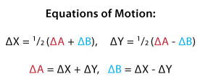
CORE XY MECHANISM
Rotating both motors in the same direction results in horizontal motion. Rotating both motors in opposite directions results in vertical motion.
If A is the degree of rotation of one motor and B is the degree of rotation of other motor then the x and y movement of the arm can be given as:

Slide 11
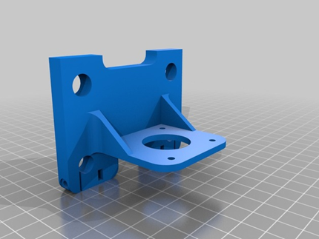
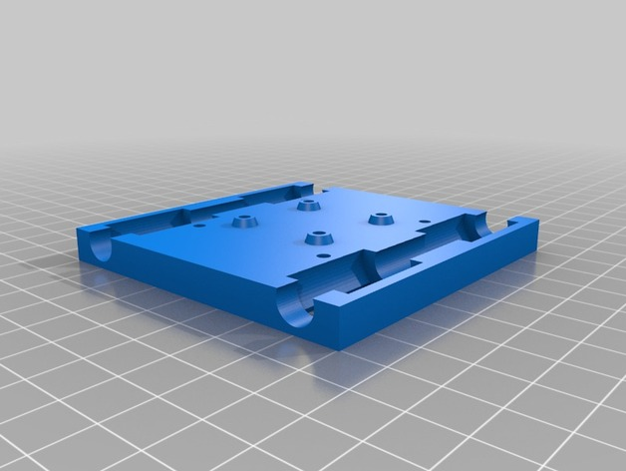
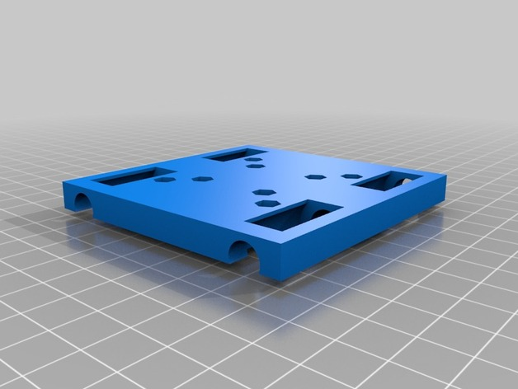
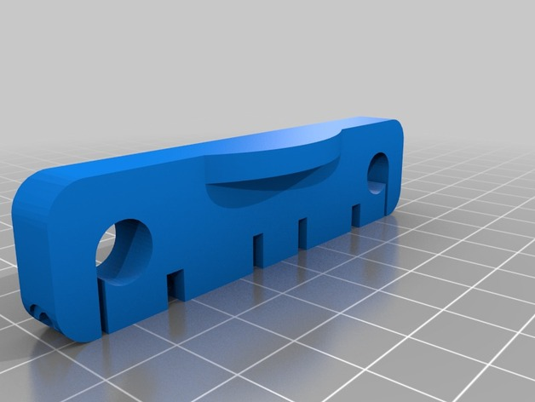
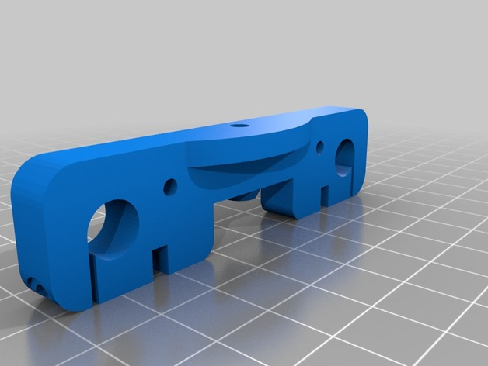

ARM DESIGN
The design of were obtained from an open source design for cartesian arm called AxiDraw. The parts were 3D printed.

Slide 12
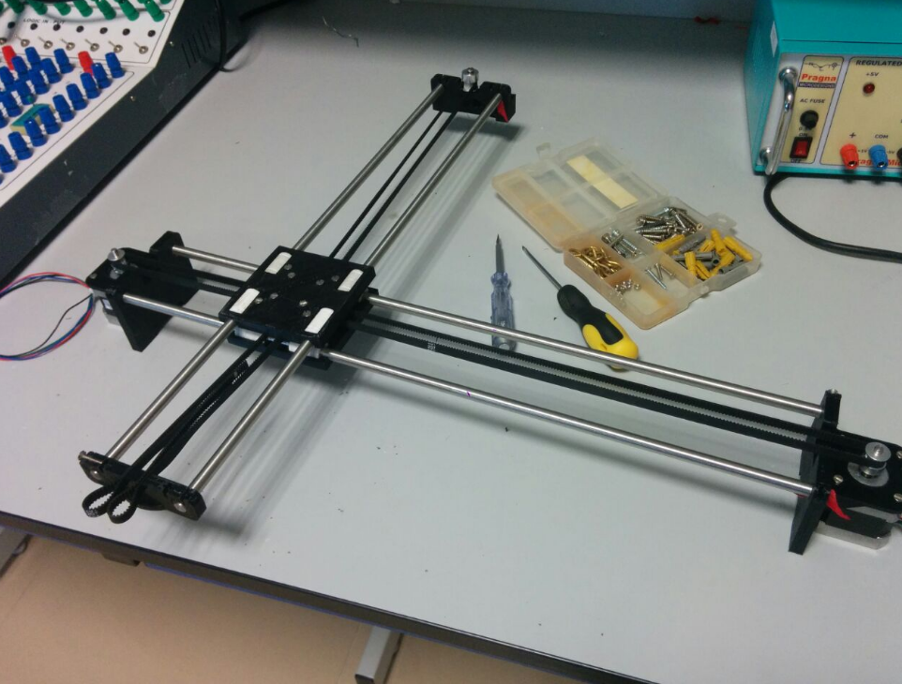
ASSEMBLY
Once the parts were printed, they were assembled. The hardware elements include four 50cm metal rods (dia. 8mm), eight LM8UU linear bearings, two timing pulleys, 9 idler pulleys and a GT2 timing belt. M3 screws of various lengths were used.

Slide 13
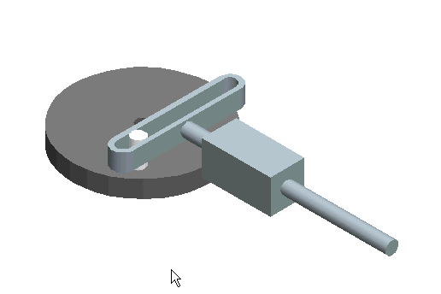
SCOTCH YOKE MECHANISM
The gripper moves in the z axis using Scotch yoke mechanism. The Scotch yoke is a reciprocating motion mechanism, converting the linear motion of a slider into rotational motion, or vice versa. The piston or other reciprocating part is directly coupled to a sliding yoke with a slot that engages a pin on the rotating part.

Slide 14
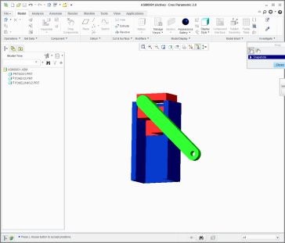
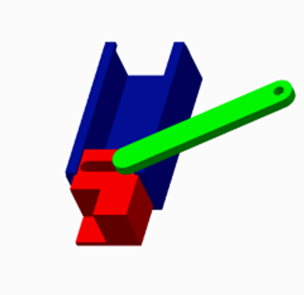
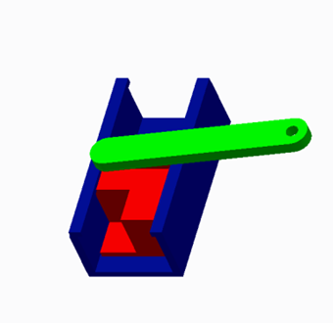
IMPLEMENTATION OF SCOTCH YOKE

Slide 15
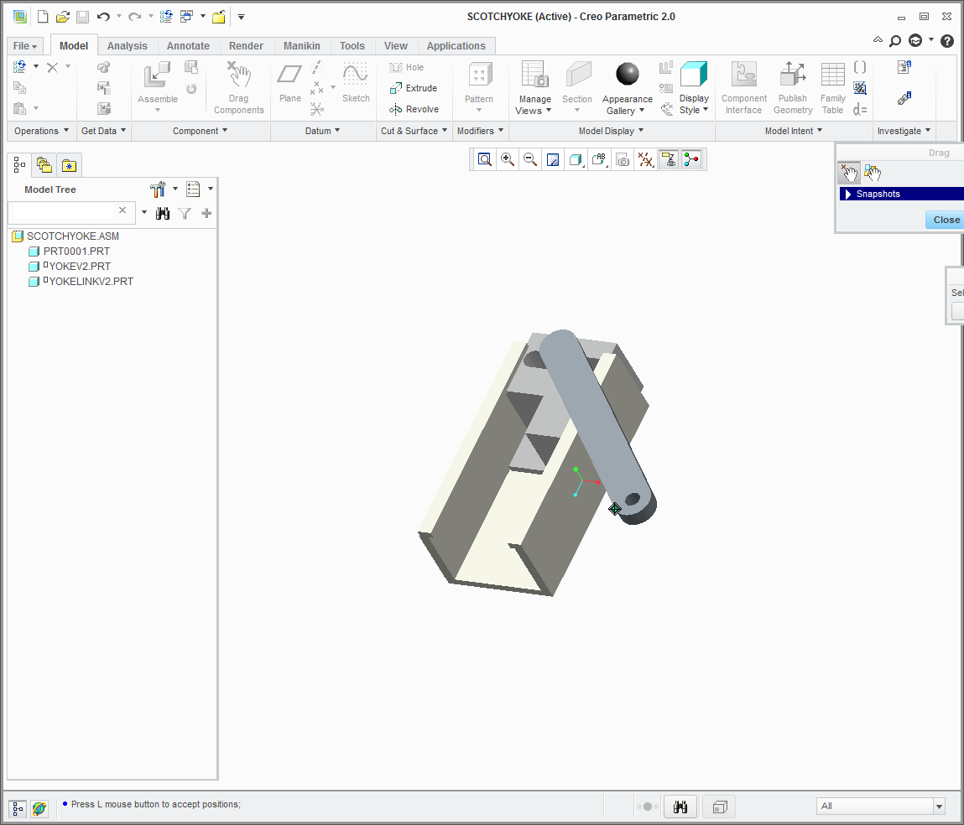


The parts of the mechanism were designed and assembled in CREO Parametric to ensure proper coupling of all parts

Slide 16
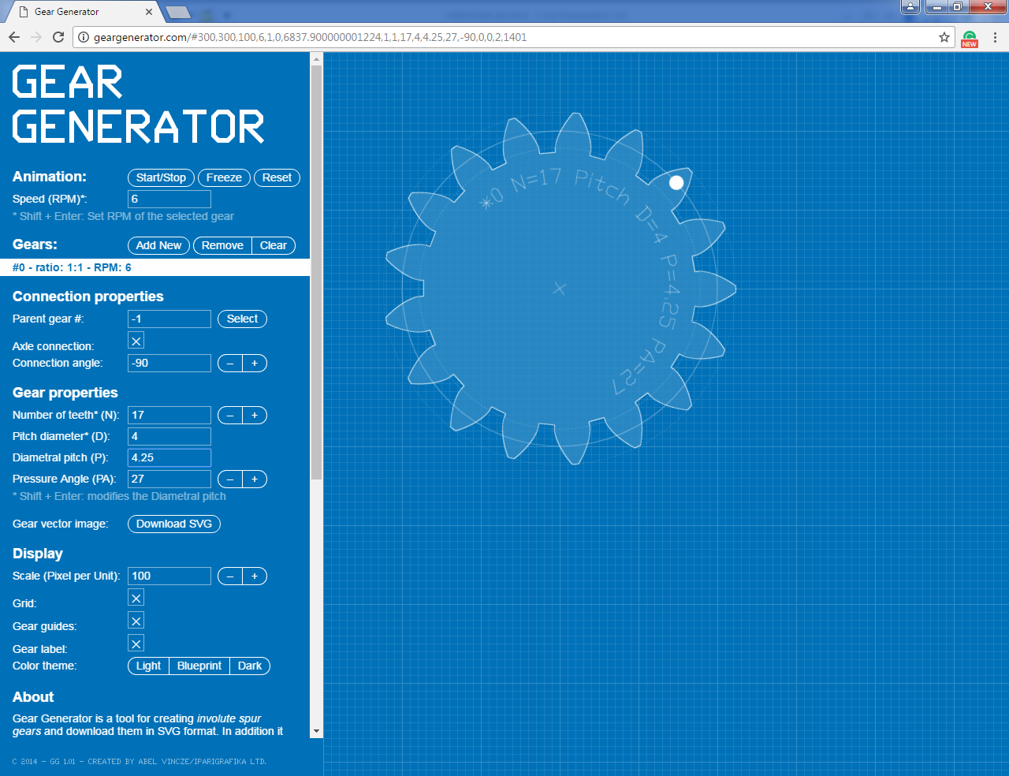
GRIPPER
The gripper is designed having two gears which mesh against each other. They were designed using geargenerator.com where the details like the pitch and are considered.
The gears were designed having 17 teeth, pitch diameter = 4 and diametrical pitch = 4.5

Slide 17
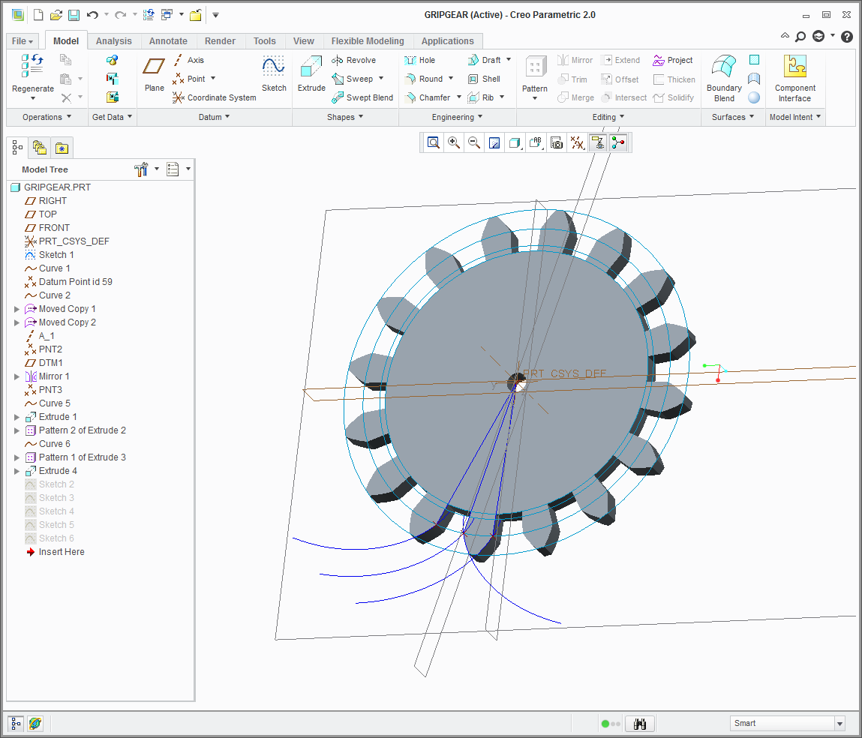
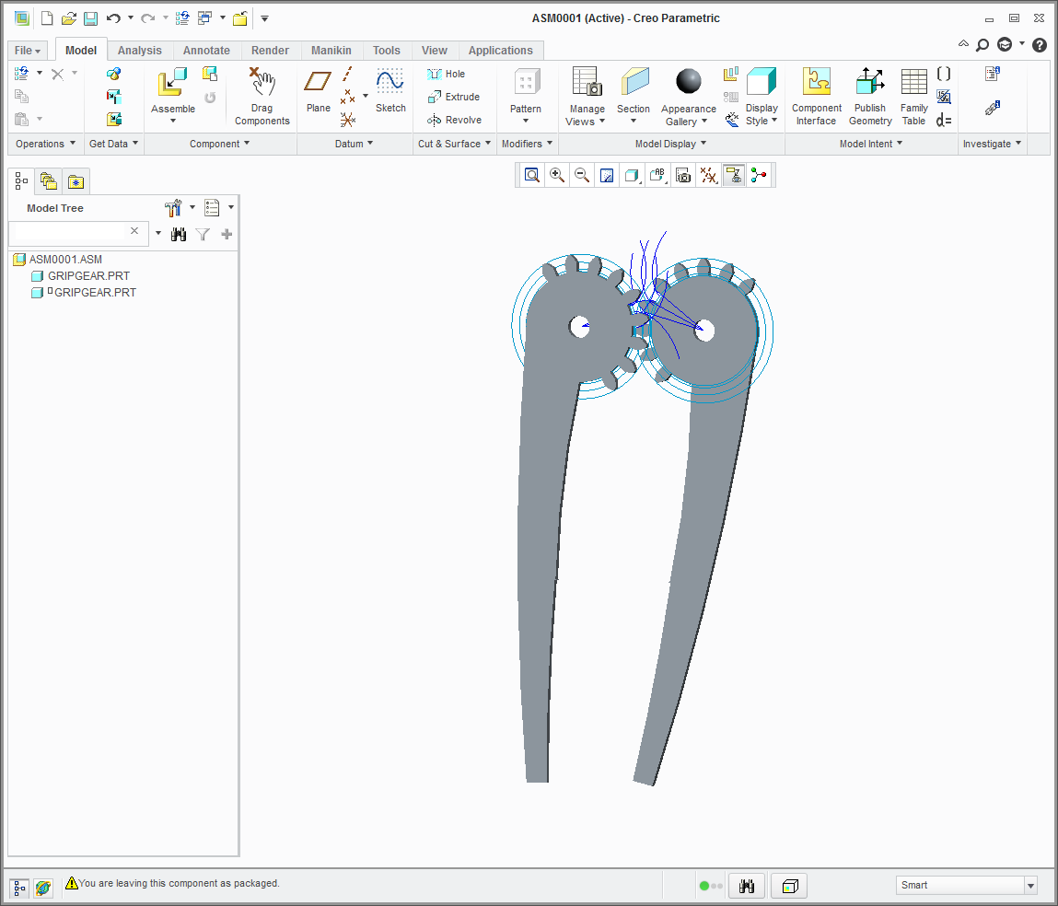
These values are used to model it in CREO Parametric to produce a 3D model. They were also assembled virtually to ensure that the gears mesh.

Slide 18
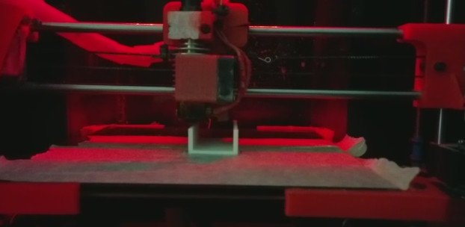
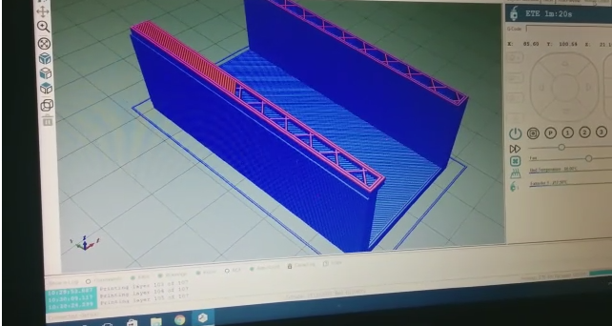

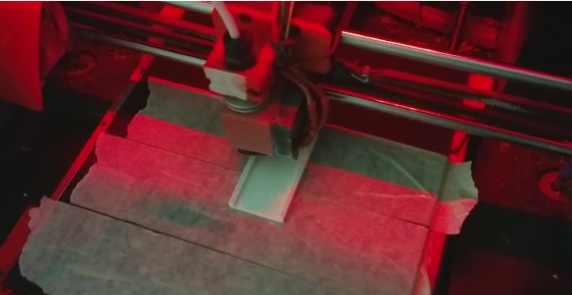
The designed parts were printed using a 3D printer with the aid of Repetier Host software.

Slide 19
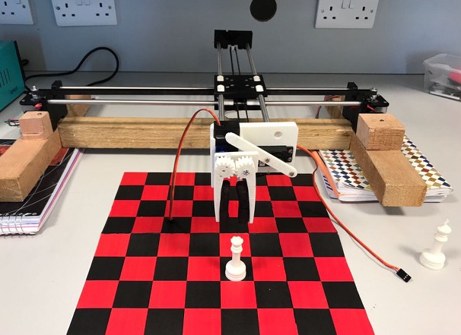
ASSEMBLED CHESSBOT

Slide 20
ELECTRICAL ELEMENTS

Slide 21
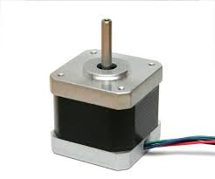
STEPPER MOTOR
The cartesian arm is actuated using a two stepper motors for x axis and y axis movements.
The stepper motor used was a NEMA 17 stepper motor.
Following are the specifications of the stepper motor:
General specifications | Electrical specifications
Step Angle- 1.8 | Rated Voltage (V)- 2.8
Temperature Rise (℃) 80 Max | Rated Current (A)- 1.8
Number of phase- 2 | Resistance Per Phase (Ω)- 1.65
Max.radial force (N)- 28 | Inductance Per Phase (mH)- 3.2
Max.axial force (N)- 10

Slide 22
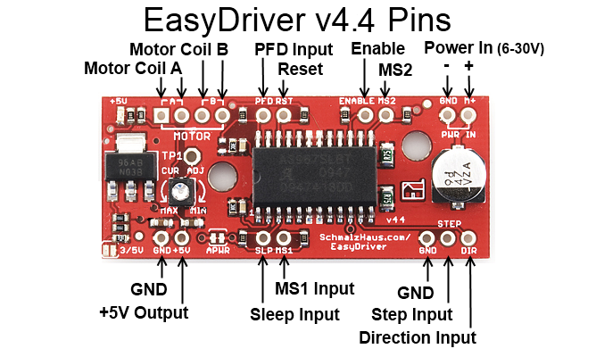
EASY DRIVER
The stepper motor is operated using Easy driver. The easy driver can output a digital 0 to 5V pulse. It requires a 6V to 30V supply to power the motor and can power any voltage of stepper motor.

Slide 23
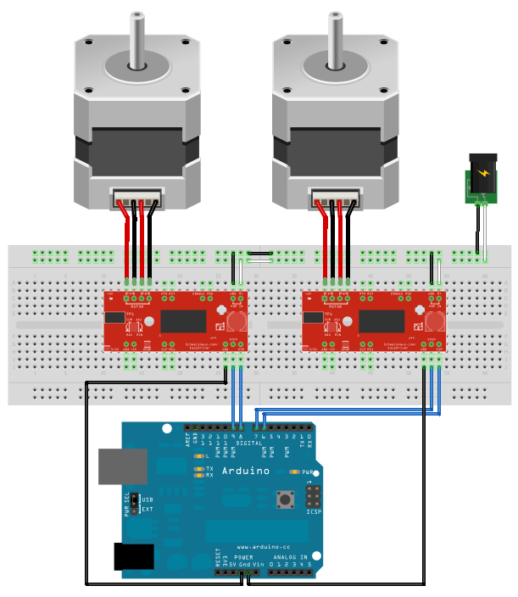
STEPPER MOTOR CONNECTIONS DIAGRAM

Slide 24
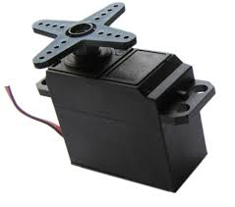
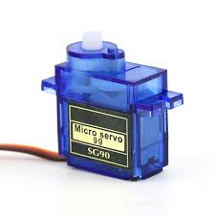
SERVO MOTORS
Servo for opening and closing of gripper
Servo for vertical movement
The gripper is actuated using two servo motors. One for vertical movement (employed by scotch yoke ) and one to open and close the gripper.
Voltage- 4.8V-6.0V
Connector type- JR type (Yellow: Signal, Red: VCC, Brown: GND)

Slide 25
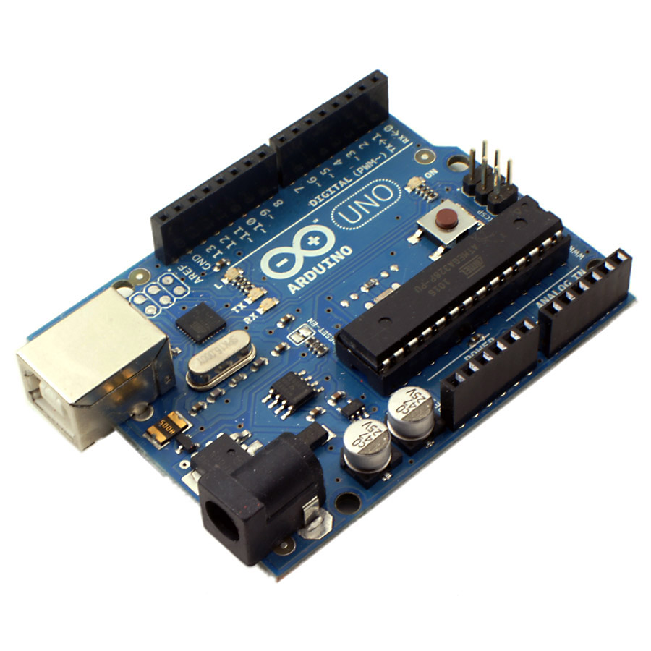

ARDUINO UNO
The motors are controlled using an Arduino UNO. It has an on board microcontroller: ATmega328. The operating Voltage of the Arduino UNO is 5V. The programming is done in Arduino IDE

Slide 26
PROGRAMMING ELEMENTS

Slide 27
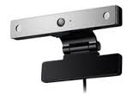


IMAGE PROCESSING
The moves made by the human are detected using a camera (LG AN-VC400)
The image processing is done using a OpenCV 3.0.0 library that runs on Python 2.7. Both the software as well as the library are open source.
The program uses the techniques such as colour detection, perspective transformation, motion detection and several other image prepossessing techniques.

Slide 28
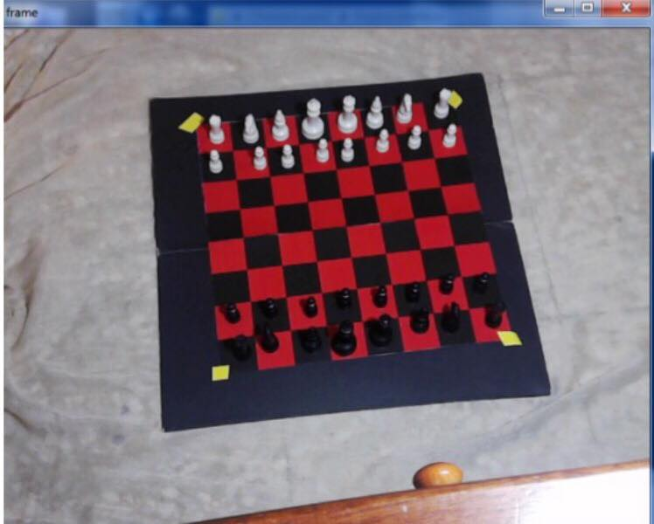
Camera view of the chess board. The yellow tapes facilitate the bot to know the exact borders of the chess board.

Slide 29
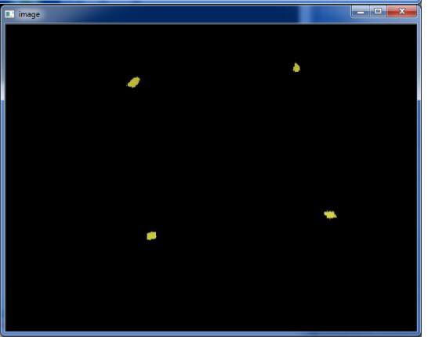
The chess board corners are detected.

Slide 30
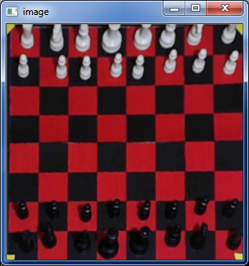
In contrast to Picture 1, the surrounding elements have been eliminated and the chess board is only focused on.

Slide 31
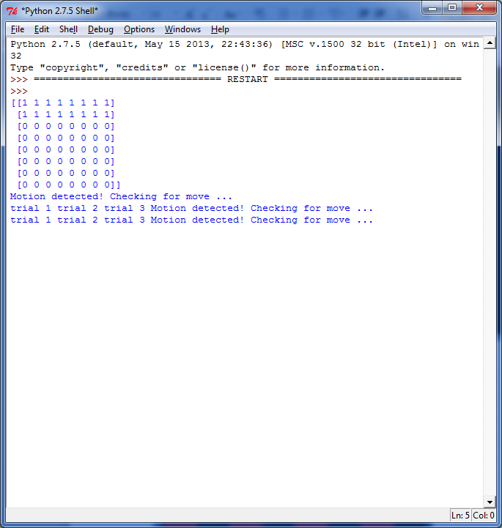
The location of the white pieces have been mapped and stored in an array. The program then waits for movement on the board

Slide 32
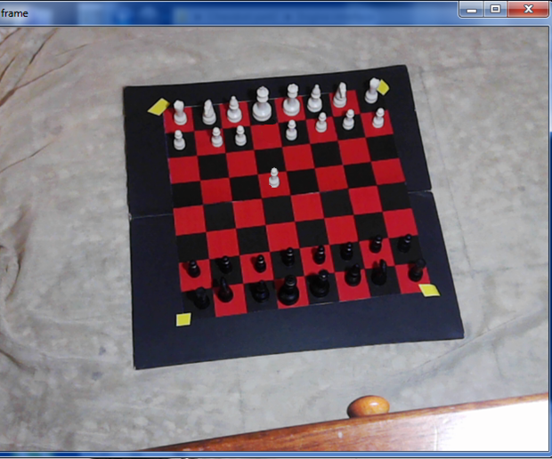
The user moves a white piece. In this case the e pawn has been moved two places , ie. e2e4

Slide 33
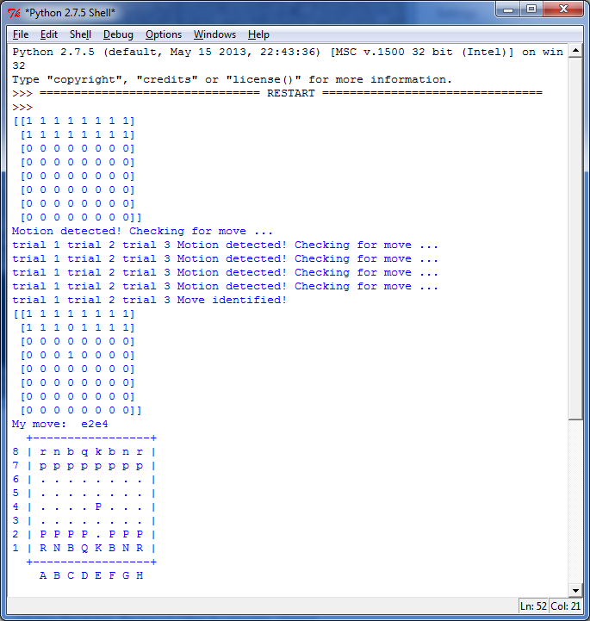
The move has been detected. Once again the pieces are mapped. The two maps are compared to identify the move made.

Slide 34
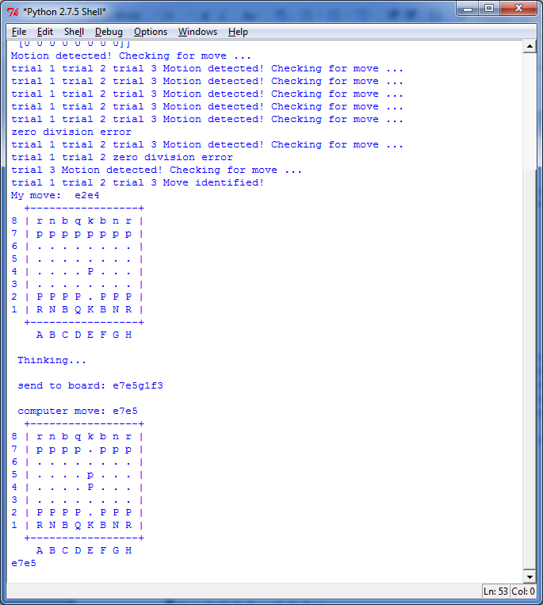
The move made by the user is sent to the chess engine which returns the best move to be made by the chessbot

Slide 35

CHESS ENGINE
The move to be made is calculated using a chess engine. A chess engine is a computer program that analyses chess or chess variant positions and makes decisions on the best chess moves.
The chess engine used here is Stockfish7. Stockfish is an open source software. It is ranked as the best chess engine according to Computer Chess Rating List. It has an Elo rating of 3483. This means that it is stronger than the best human grandmasters.

Slide 36

SERIAL COMMUNICATION
Once the move to be made is decided, the required motor actuation is calculated and then serially communicated from the pc through Python to the Arduino UNO. The serial communication occurs at 9600 baud rate through the COM port.

Slide 37
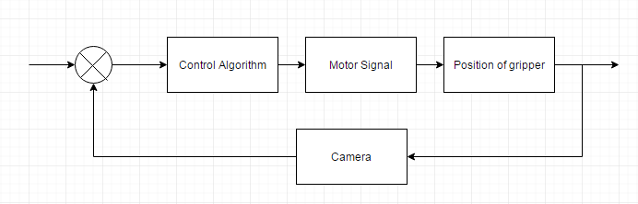
CONTROL SYSTEM
Desired position
Actual position
During motion of the arm, the camera tracks its position so that it reaches the desired location. Hence it is a closed loop control system.

Slide 38

Thank You

